Slide 1

Getting started with the Westberg Knowledge Sharing Platform

Slide 2

By joining this platform, you are helping all of us. The value of the platform increases with each and every person who signs up.
To access the Westberg Knowledge Sharing Community, navigate to https://community.westberginstitute.org/ and click on “Community” in the top ribbon.

Slide 3
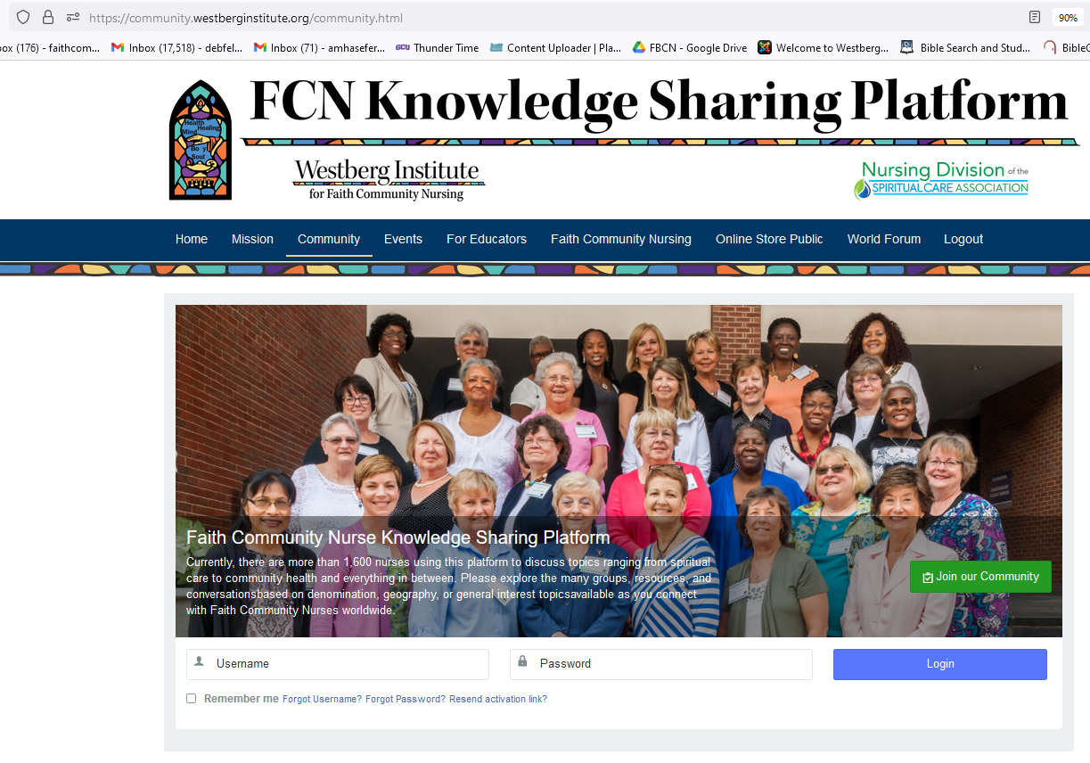
Setting up an account and logging in
You will now be at https://community.westberginstitute.org/community.html
If you have an account already, log in here with your user name and password.
If you are new to the platform, click the green box that says “Join our Community.” The system will ask a few questions and when you submit it, it comes through the system to Deb Ziebarth. You will get an invitation back to join. That return email often goes into Spam, so be sure to check there because you need to respond within 24 hours.

Slide 4
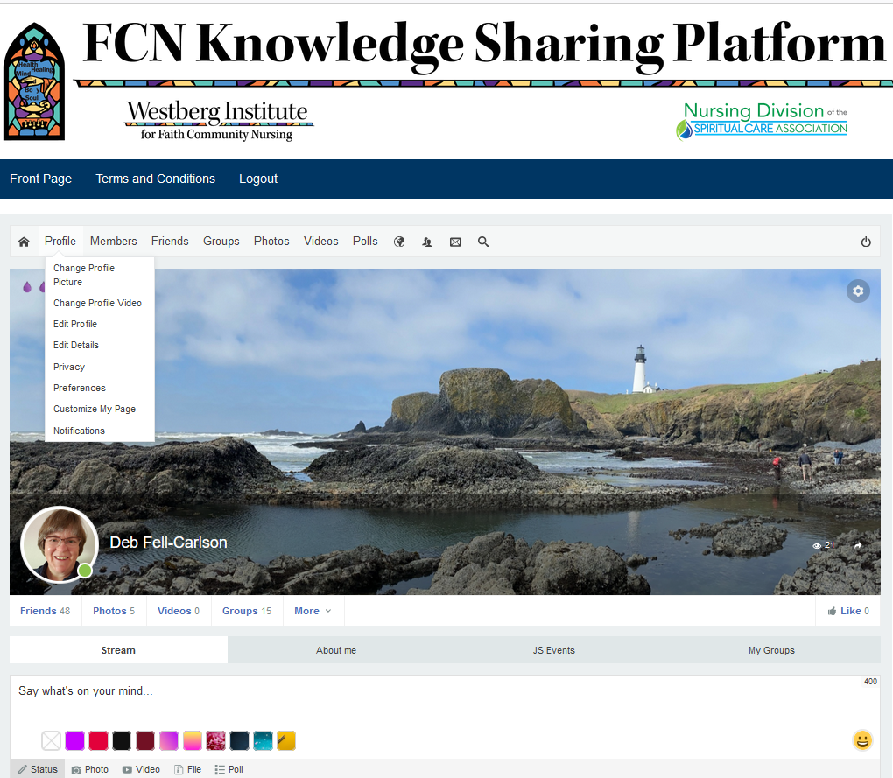
Please take a few minutes to set up your profile.
Please use your first and last name and put in a profile picture so we can connect your face to your name.
You can find these options in the Profile drop-down menu shown here. This is also where you change your sign-in credentials.
If you want to quickly view your notifications, you can click on the bottom option in the drop-down menu. You get notifications for similar things as you would get in LinkedIn, FaceBook, or X.
In this example, the profile picture is the little picture of my face. The larger picture of the Oregon Coast is the Cover photo. We will talk about that next.
Creating your profile and adding your picture

Slide 5
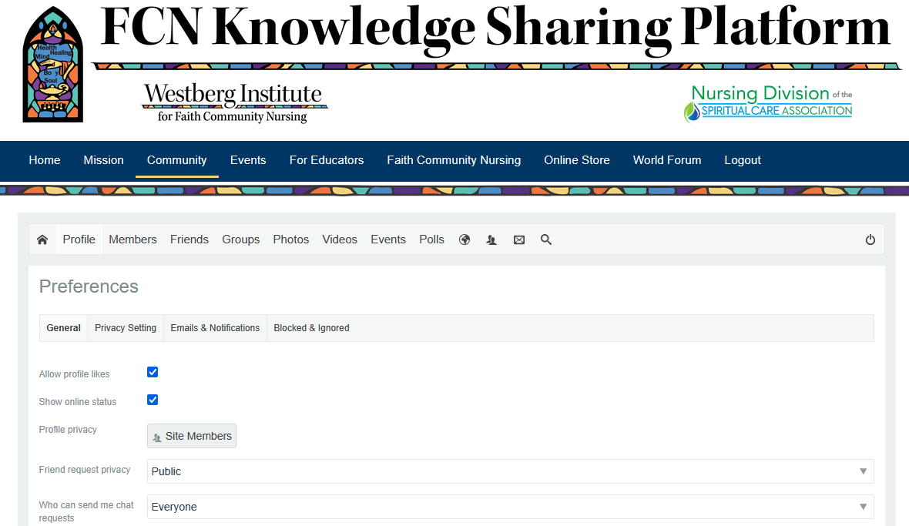
To optimize platform effectiveness for everyone, set your notification preferences to receive emails when someone sends you a message or posts an announcement.
In the same Profile drop-down menu shown here, click on Preferences.
It will look like this.
Making sure you stay connected

Slide 6
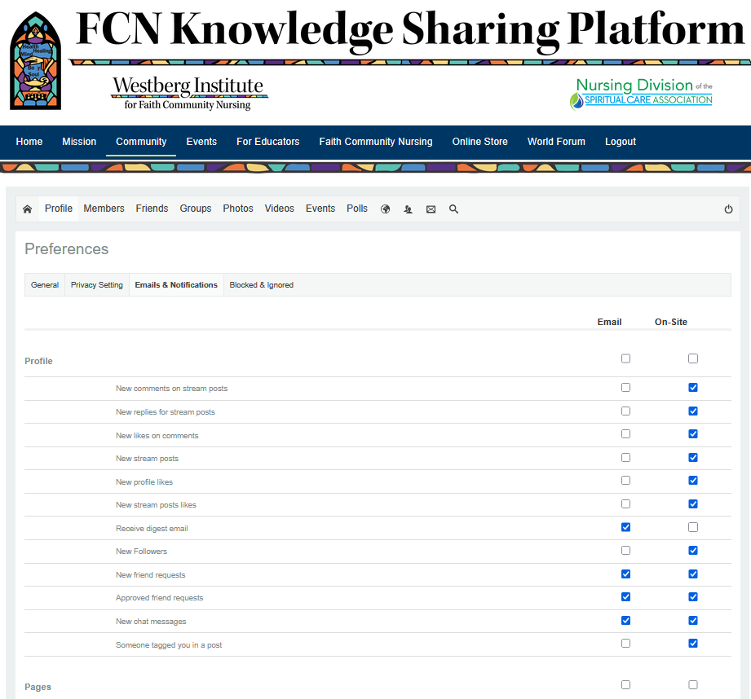
You can choose which types of notifications you want to stay informed. The list is extensive, so check it out! Only part of it is shown here.
Click on Emails and Notifications and click which notifications you want to receive in your email (“email”) and which ones you want to get when you are moving around inside the platform (“On-Site”).
Making sure you stay connected

Slide 7
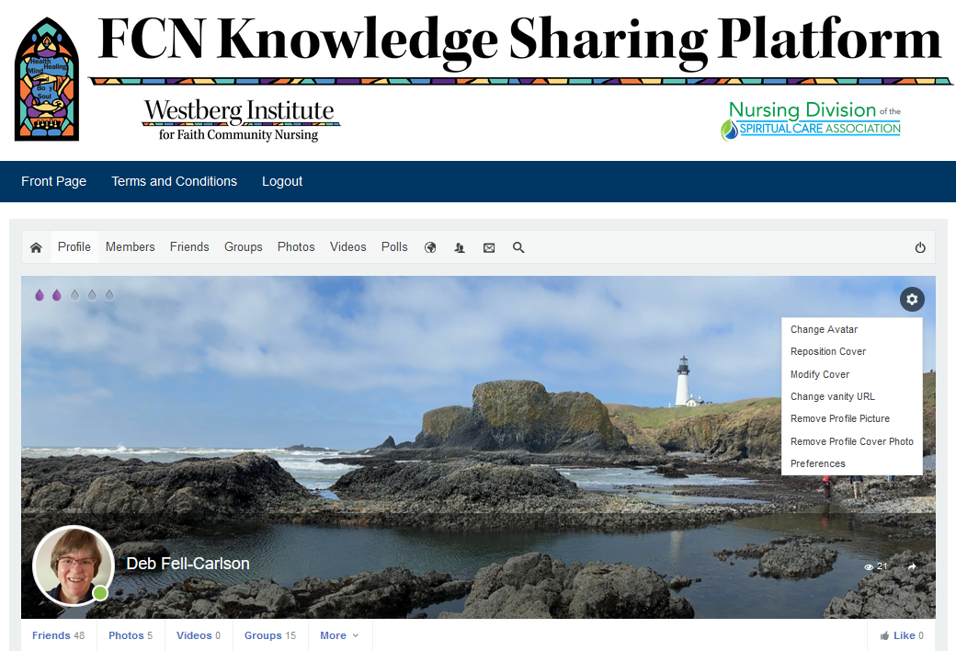
Putting in a cover photo and setting preferences
Click on the SETTINGS gear shown near the top of the orange oval to show this dropdown menu. This is where you click to put in your cover photo. You can put in a picture of your church, your family, scenery near you, or your logo – whatever suits you. You can move it around or take it away here, also.
PREFERENCES is where you will find your privacy settings and some tools to make the Platform more useful. This will take you to the same place as the link on the dropdown under PROFILE on the previous slide. For example, you can check a box to tell the system to send you an email if somebody sends you a message on the Platform. This is helpful for when you are busy and cannot check the Platform as often as you would like.

Slide 8
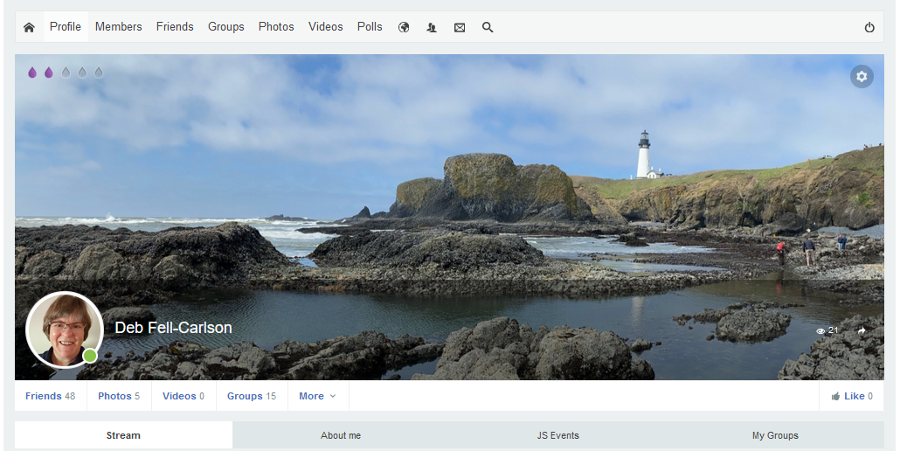
Checking out Platform members
This opens a list of all the members on the Platform. The list is alphabetical, or you can put a name in the search field.
Try it out.
Once you open this, you will see how important it is to put your full name and profile picture in your profile.

Slide 9
Either of these opens a list of all the Platform members who are my Friends already. These individuals have accepted my “Friend” request or have sent one to me and I have accepted.
You can also see pending friend requests waiting for you to respond, and ones you have sent awaiting their response.
What if you want to connect with someone who is NOT a Platform member? That is next.
Connecting with Platform members

Slide 10
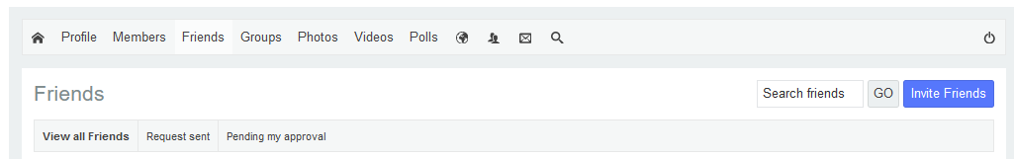
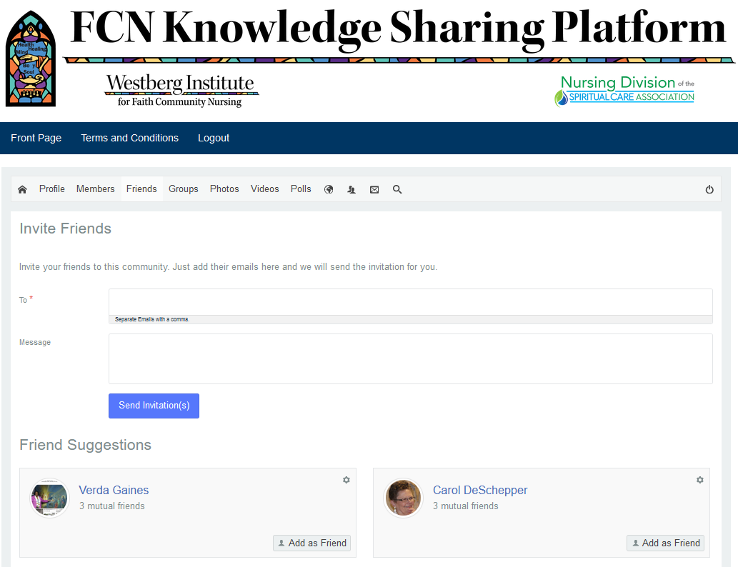
Connecting with colleagues who are not yet on the Platform
When I click on Friends and see the list, I search using the search box or I can pick from the names that show up there.
Notice that there is an option at the top to INVITE Friends. See the orange oval in the top picture. When I open that, I get a form that allows me to invite others to the Platform using their email address. You can put in a bunch at a time. Click “send” when you are done.

Slide 11
This opens a list of all the Groups on the Platform.
Here you can choose from among the Groups you have already joined.
Joining groups is really important. If you don’t see a local group, you can create one easily by clicking the blue button that says CREATE GROUP. Each group has a profile picture, which is often their logo, and a cover photo.
Next we will provide suggestions for which Groups to join first.
Checking out Groups

Slide 12
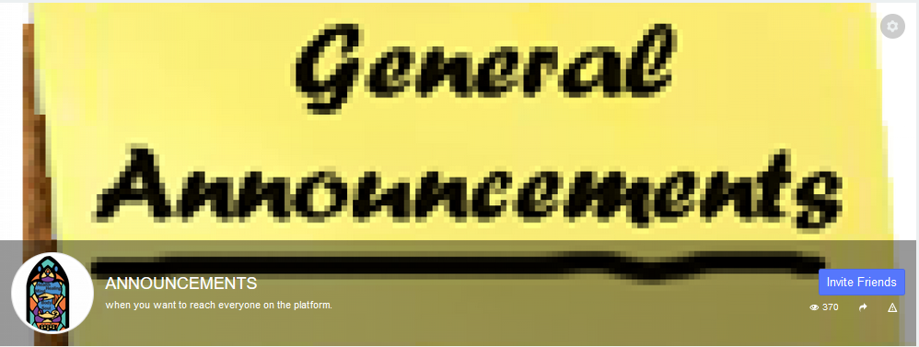
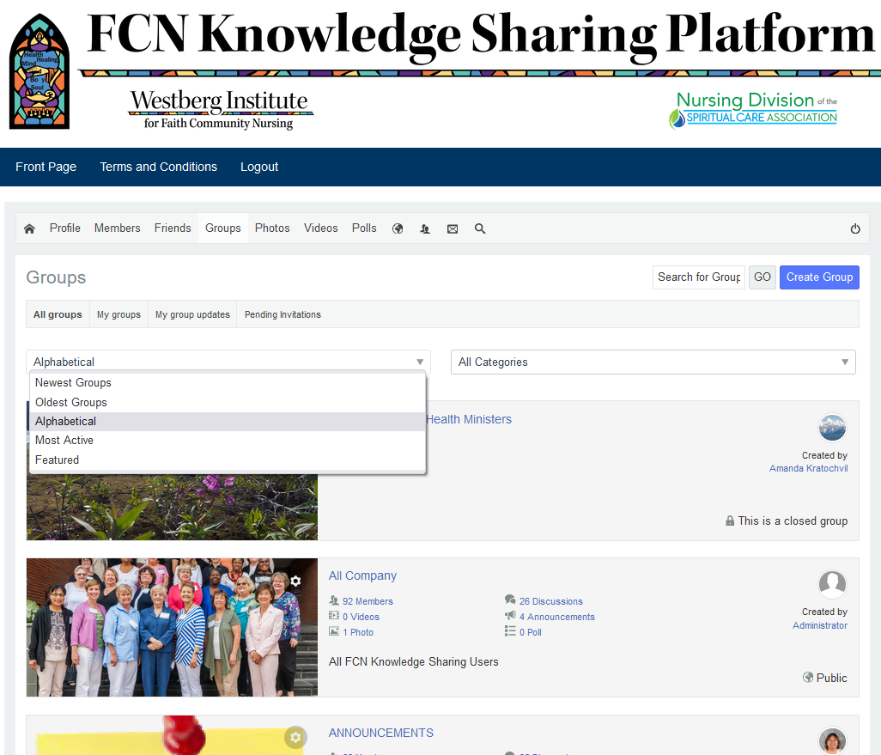
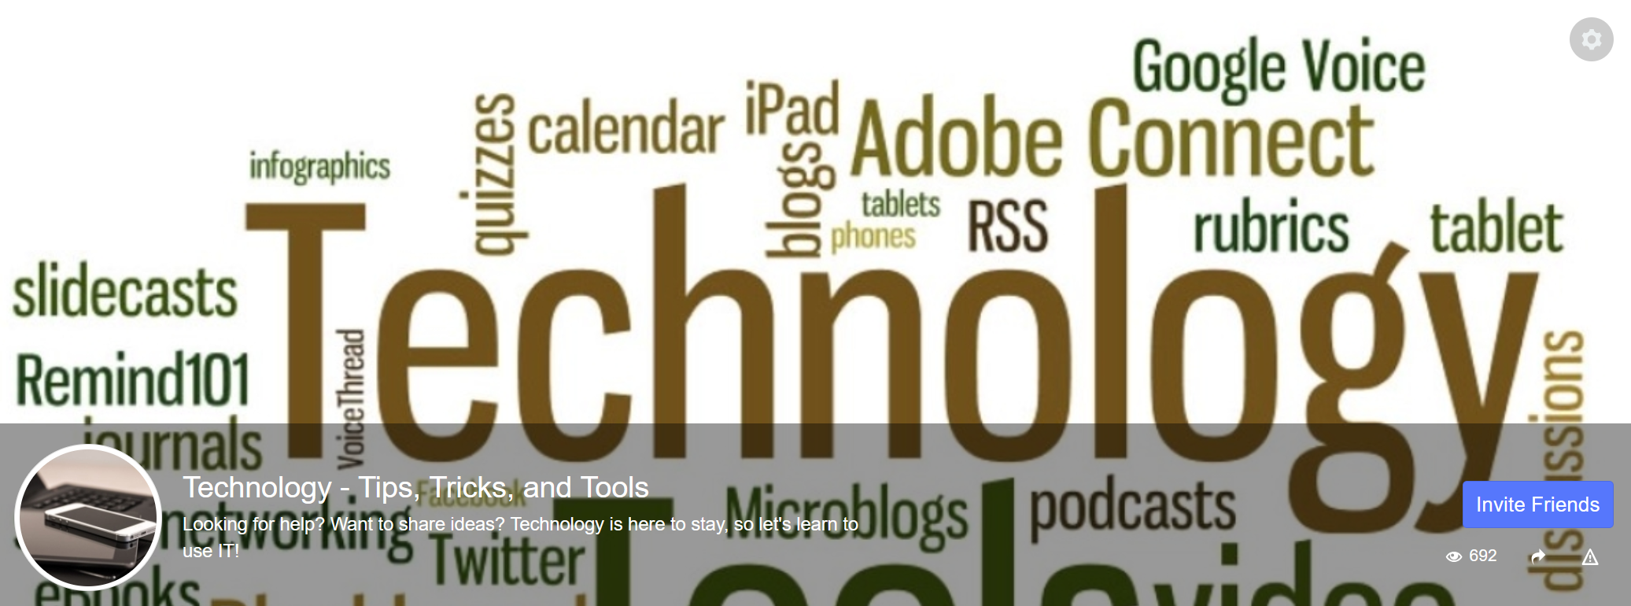

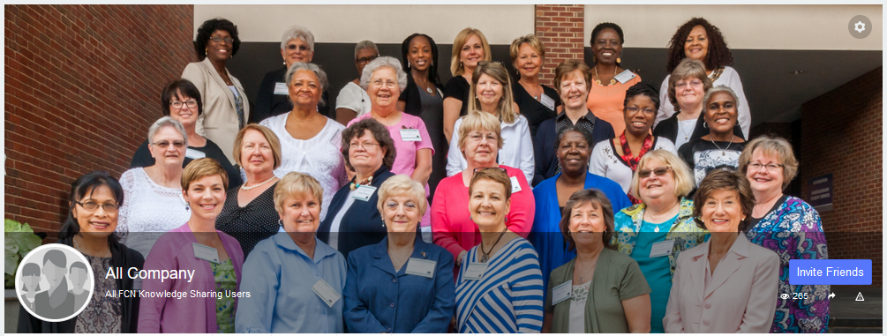
Recommended “Starter” Groups and joining Groups
Filter newest, oldest, alphabetical, most active, and featured.
There are many groups. Join any and all that interest you. If you don’t see it, CREATE it! There is a Group for new FCNs, Educators, Coordinators… you name it! If you find a group you like, you can INVITE your friends!
There is a filter at the top of the Groups page that allows you to view just the newest Groups added. It also allows you to look at just your Groups, any updates from just your Groups, and any invitations to Groups that are still hanging out there. You might want to follow up!

Slide 13
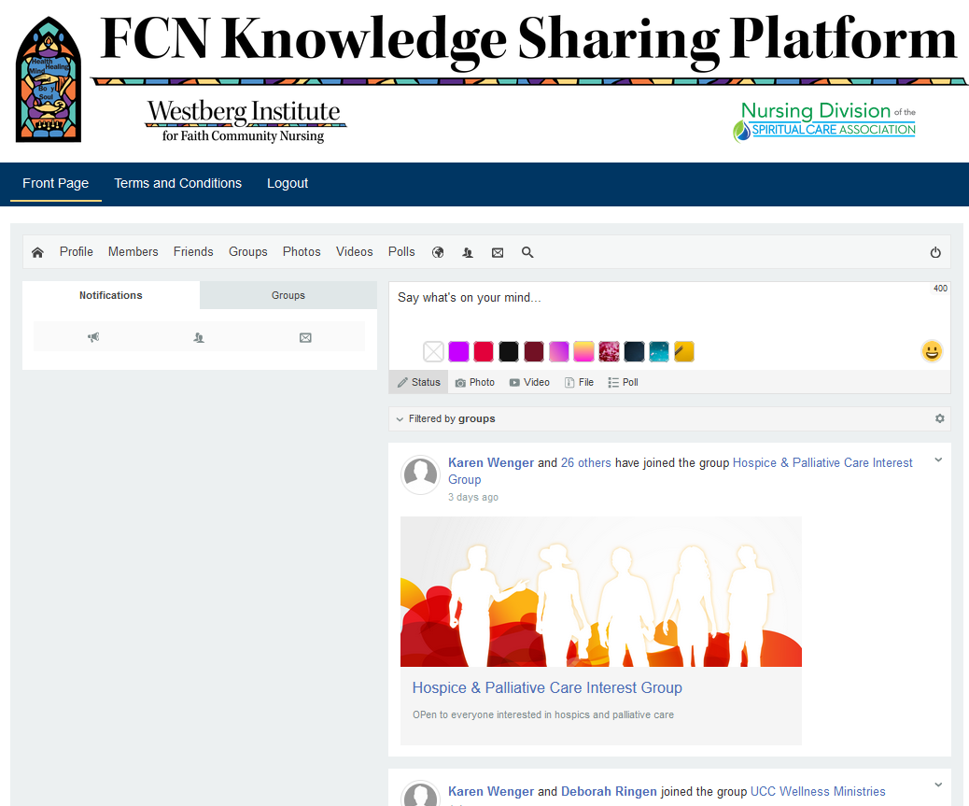
Communicating on the Platform
Everything discussed so far has been from the Profile page. When you log in next time, you will probably see the FRONT PAGE. You can go back to it at any time by clicking on the words “Front Page.”
The tabs are similar to your profile page.
New posts appear here.
You can post here on the Front Page.
You can access anything from here that you can access from your Profile page.

Slide 14
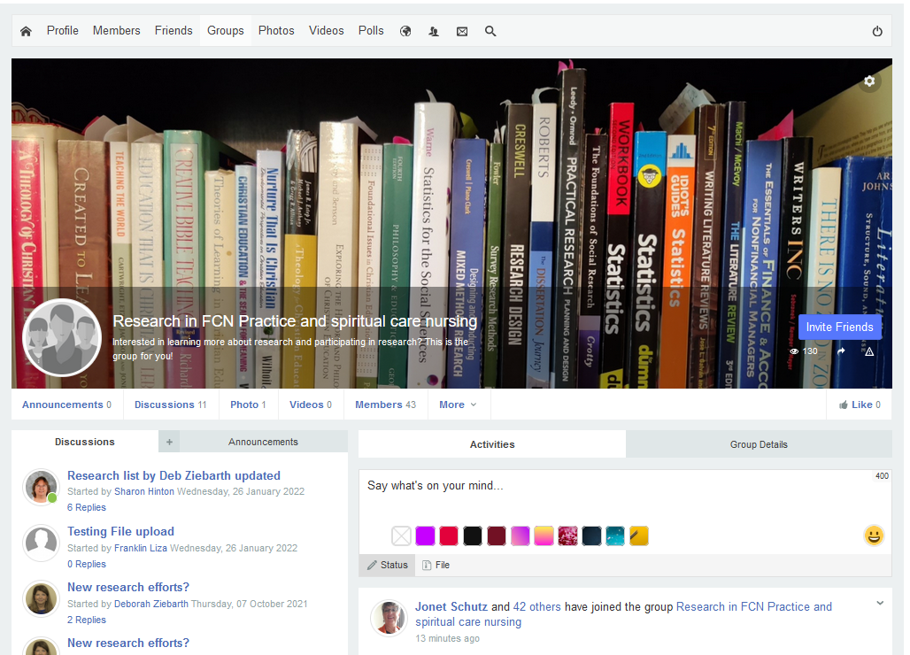
Let’s see how to connect with colleagues in the various groups we have joined.
You can see options for Discussions and Announcements. Discussions allow dialogue. Announcements do not; they are just that… announcements. Click on the Discussion or Announcement tab based on what you are posting and whether you want responses.
This Group has several discussions underway, and the new Research list has been updated and posted. That suggests there might be a file there, so let’s take a look at what happens if I click on the post called “Research list by Deb Ziebarth updated”…
Communicating within Groups

Slide 15
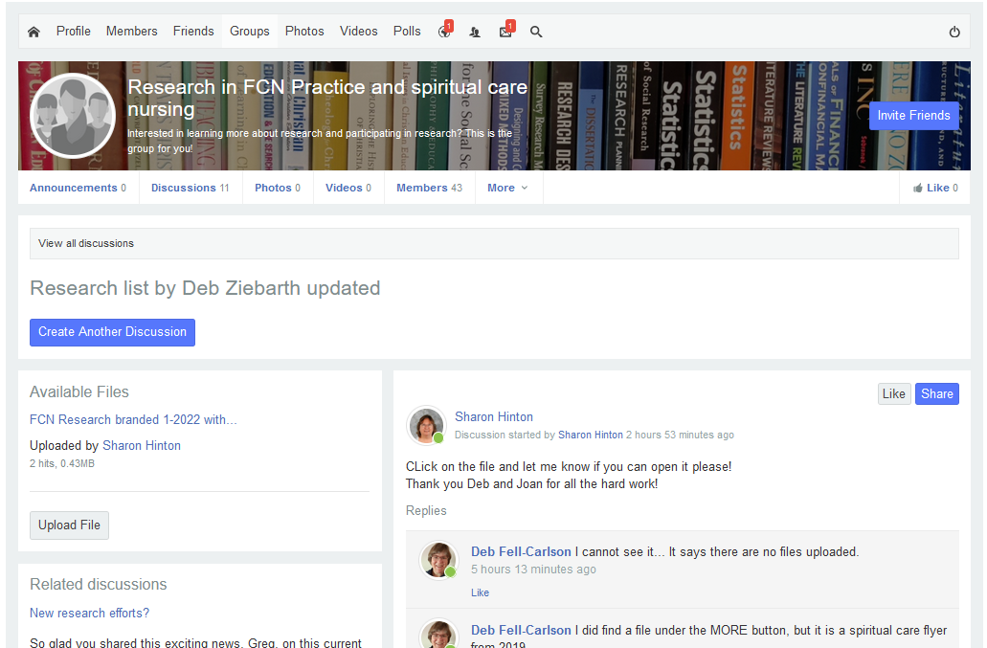

Communicating within Groups
I clicked on the post titled “Research list by Deb Ziebarth updated.” I have several options here:
I can reply by typing in the “Add a comment” box and enter the discussion. I can add a picture or an emoji with my comment, similar to FaceBook. I can also “like” or “share” the post to other social media apps or to someone on email.
I can click the title of the file and download it to my computer.
If I have a photo or document to add to the discussion, I could upload it here. Caveat: Files have to be in some sort of image format (like .jpg) or in .pdf to upload.
Let’s look at another Group page to see the difference between a Discussion post and an Announcement post. That is next.

Slide 16
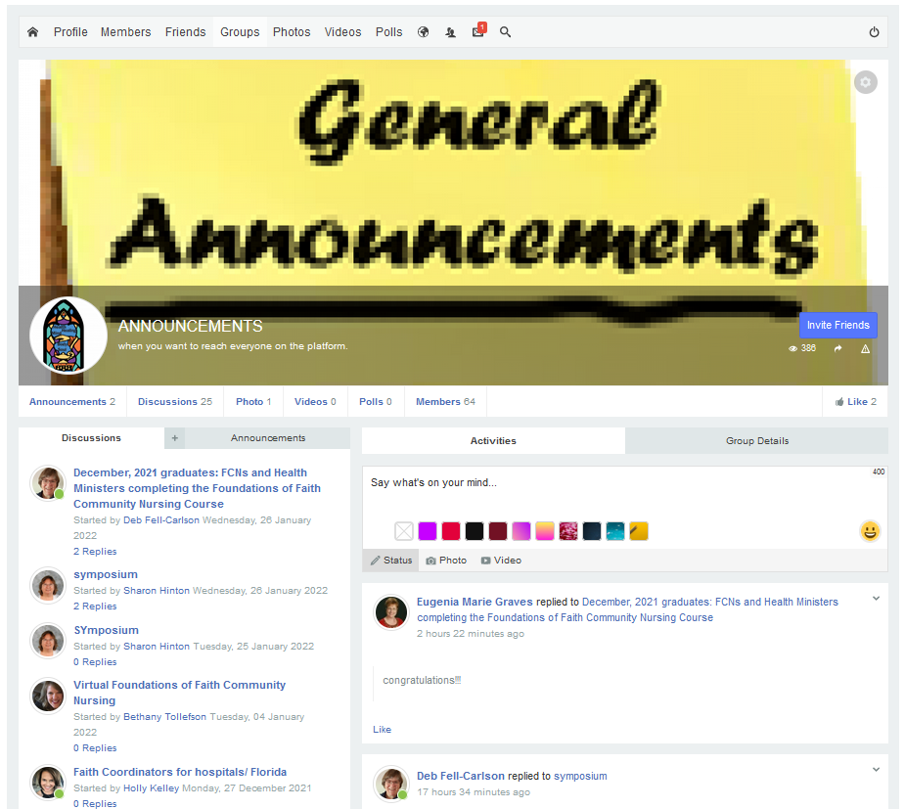
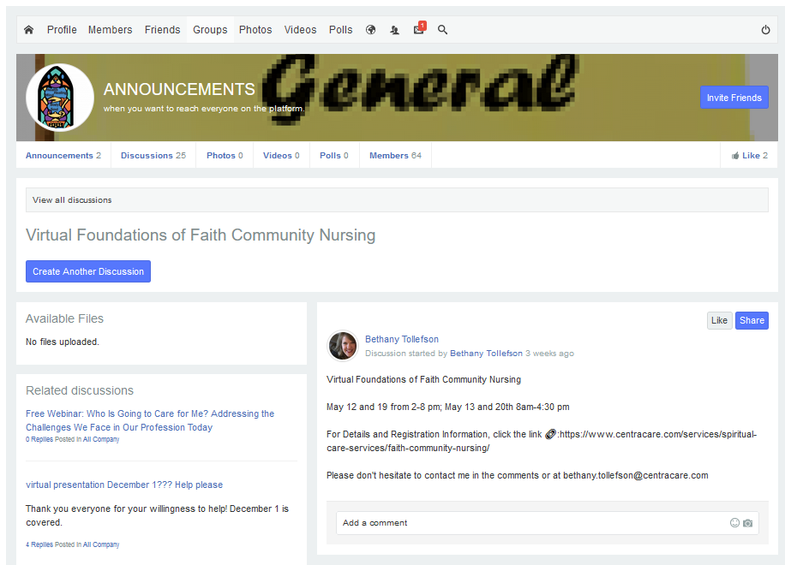
Discussions
Communicating within Groups
I can engage with this discussion. I can upload a pdf or jpg file, add a comment, or connect in one of the related discussions. I can also initiate a new discussion. I cannot engage with an announcement, as you will see next.

Slide 17
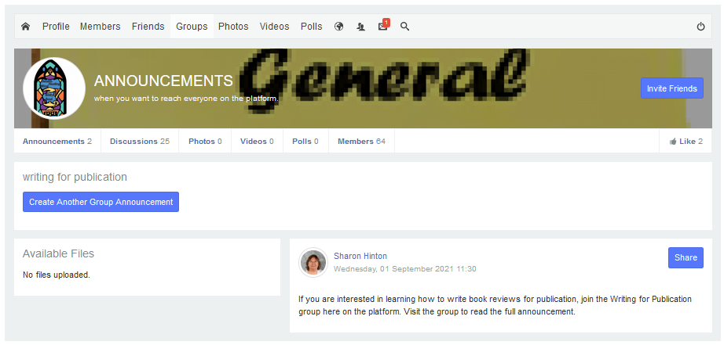
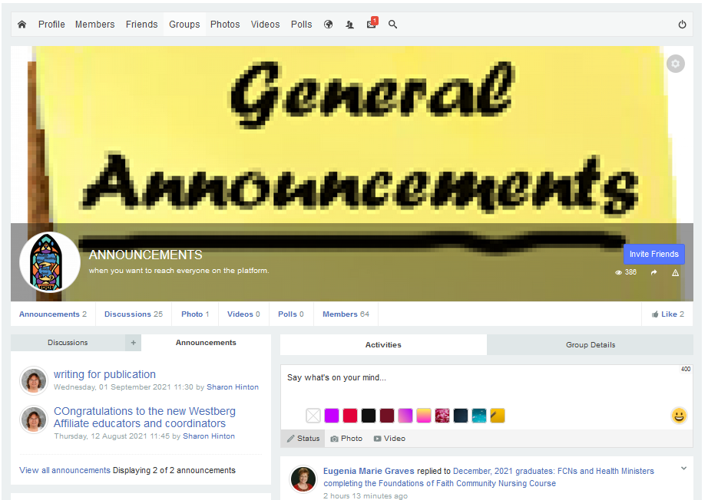
Announcements
Communicating within Groups
There is no option to enter a comment or engage in any way when you open an announcement. You can start a new discussion, or you can share the announcement.

Slide 18
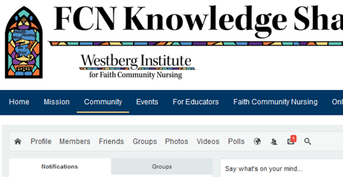
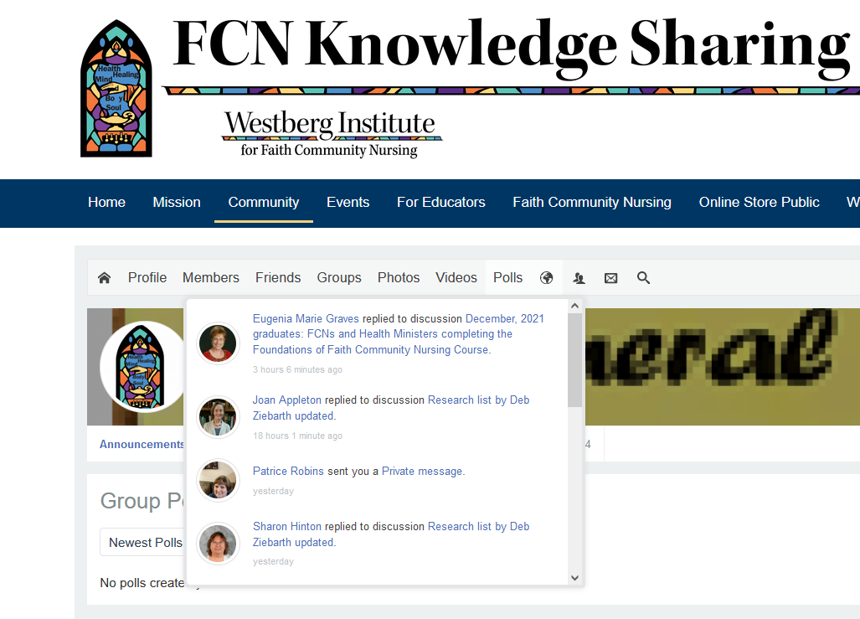
Responding to others
Communicating within Groups
When you have an unread notification, you will see a little number by the icon, like you see here by the message icon.
When you click on the world, it brings up activities others have engaged in…

Slide 19
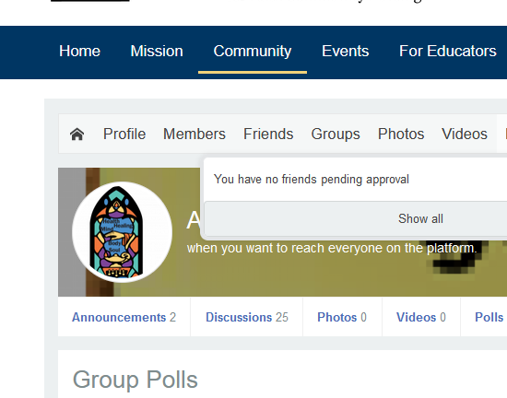
Responding to others
Communicating within Groups
When you have an unread notification, you will see a little number by the icon, like you see here by the message icon.
When you click on the People icon, it gives you status of Friend requests.

Slide 20
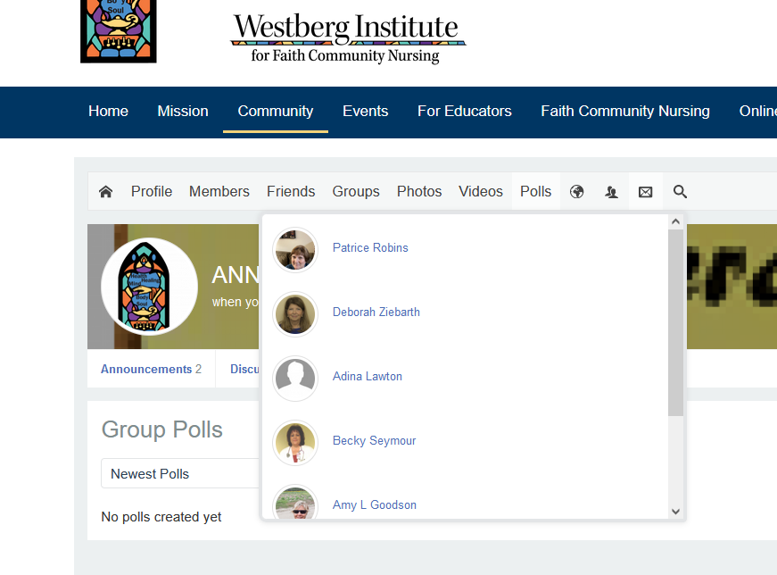
Responding to others
Communicating within Groups
When you have an unread notification, you will see a little number by the icon, like you see here by the message icon.
When you click on the envelope icon, it brings up a list of folks you have messaged or who have messaged you. You can click on the name and view the message.

Slide 21
Please tell us what you learn!
We will be updating this as we learn more about the platform. There is a polling option; try it out and let us know how it goes.
In the meantime, please message me if something isn’t working: Deb Ziebarth, admin@westberginstitute.org

